Slide 1

COMS 3009/28A Software Design
University of the Witwatersrand, Johannesburg
School of Computer Science and Applied Mathematics

Slide 2

Software Testing

Slide 3
What is Software testing?

Slide 4
Software testing is the process of evaluating a software solution to ensure that it behaves as expected and meets the specified requirements.
It involves executing the software under controlled conditions and assessing its behavior to identify any defects or bugs.

Slide 5
Bugs?
A fault, also called a bug or a defect, is an erroneous software or hardware element of a system that can cause the system to fail

Slide 6
Why do we test?
Finding defects: Software testing helps identify defects or bugs in the software, such as errors in functionality, performance issues, or inconsistencies in the user interface.
Ensuring quality: Testing ensures that the software meets the quality standards and fulfills the requirements specified by stakeholders. It aims to deliver a reliable and robust product to end-users.
Validating requirements: Testing verifies that the software behaves according to the specified requirements, ensuring that it meets the needs of its users and stakeholders.
Improving user experience: By identifying and fixing defects, testing helps improve the overall user experience of the software, making it more user-friendly and satisfying to use.

Slide 7

NB:
However, “testing shows the presence, not the absence, of bugs” - Edsger W. Dijkstra
We can never be 100% sure that the software is bug-free
But we can get close with proper testing methodology

Slide 8
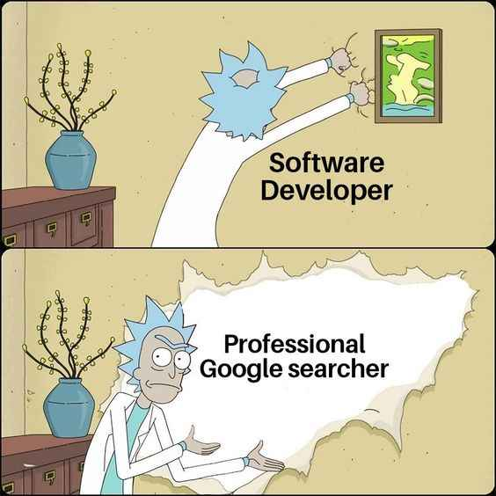
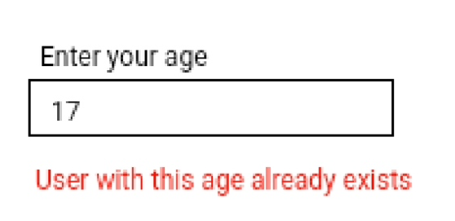
But, Lucky, I’m a good software developer
Do I really need to test my software?

Slide 9

Do I need to test my software?

Slide 10
The question to ask
are tests conducted haphazardly by random trial and error?
or, are tests conducted systematically with a plan?

Slide 11
Methodology

Slide 12


Slide 13

Test-Driven Development (TDD)

Slide 14
TDD
TDD, or Test-Driven Development, is a software development approach in which tests are written before the actual implementation code.
Core principles:
Every step in the development process must start with a plan of how to verify that the result meets a goal
The developer should not create a software artifact (a system requirement, a UML diagram, or source code) unless they know how it will be tested

Slide 15
TDD Steps: "Red-Green-Refactor" cycle
Write a failing test (Red): In this step, the developer writes a test case that specifies the desired behavior or functionality of the code to be implemented. Since there is no implementation code yet, the test case will fail initially.
Write the minimal implementation code to pass the test (Green): In this step, the developer writes the minimum amount of code necessary to make the failing test pass. The focus is on writing code that fulfills the requirements of the test case without introducing unnecessary complexity or functionality.
Refactor the code (Refactor): After the test case passes, the developer refactors the code to improve its design, readability, and maintainability while keeping all tests passing. This step ensures that the codebase remains clean and well-structured as new functionality is added.

Slide 16
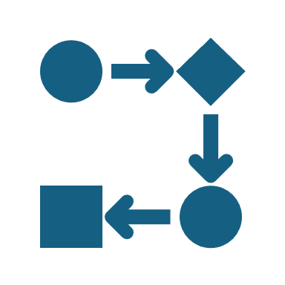
TDD
The TDD process is iterative, meaning that after the code is refactored, the cycle repeats with additional test cases or modifications to existing ones. This approach encourages developers to write tests that verify the behavior of their code and to focus on writing code that satisfies those tests.

Slide 17
TDD offers several benefits, including:
Improved code quality: TDD encourages developers to write modular, well-designed code that is easier to understand, maintain, and extend.
Reduced bugs: By writing tests upfront and continuously running them, developers can catch bugs early in the development process, reducing the likelihood of defects in the final product.
Faster feedback loop: TDD provides rapid feedback on the code's behavior, allowing developers to identify and address issues quickly.
Better documentation: Tests serve as executable documentation, describing the intended behavior of the code and providing examples of its usage.
Notes:
Overall, TDD is a disciplined approach to software development that promotes code quality, reliability, and maintainability by prioritizing testing throughout the development process.

Slide 18
Key definitions
A fault, also called “defect” or “bug,” is an erroneous hardware or software element of a system that can cause the system to fail
A test case is a particular choice of input data to be used in testing a program and the expected output or behavior
A test is a finite collection of test cases
White-box testing exploits structure within the program (assumes program code available)
Black-box testing explores input space of functionality defined by an interface specification

Slide 19

Testing is hard

Slide 20
Why testing is hard
Any nontrivial system cannot be completely tested
Example: testing 4-digit numeric keycodes
You never know with certainty that all 4-digit codes work as expected unless you try all
But, what happens with “incomplete” (3-digit, 2-digit) codes? Will all of them timeout to reset state?
Or, will all tuples (pairs, triplets, etc.) of successive incomplete codes timeout to the reset state?
Our goal is to find faults as cheaply and quickly as possible.
Ideally, we would design a single “right” test case to expose each fault and run it
In practice, we have to run many “unsuccessful” test cases that do not expose any faults
A key tradeoff of testing:
testing as many potential cases as possible (high degree of “test coverage”) while keeping the economic costs limited
Underlying idea of software testing:
the correct behavior on “critical” test cases is representative of correct behavior on untested parts of the state space

Slide 21
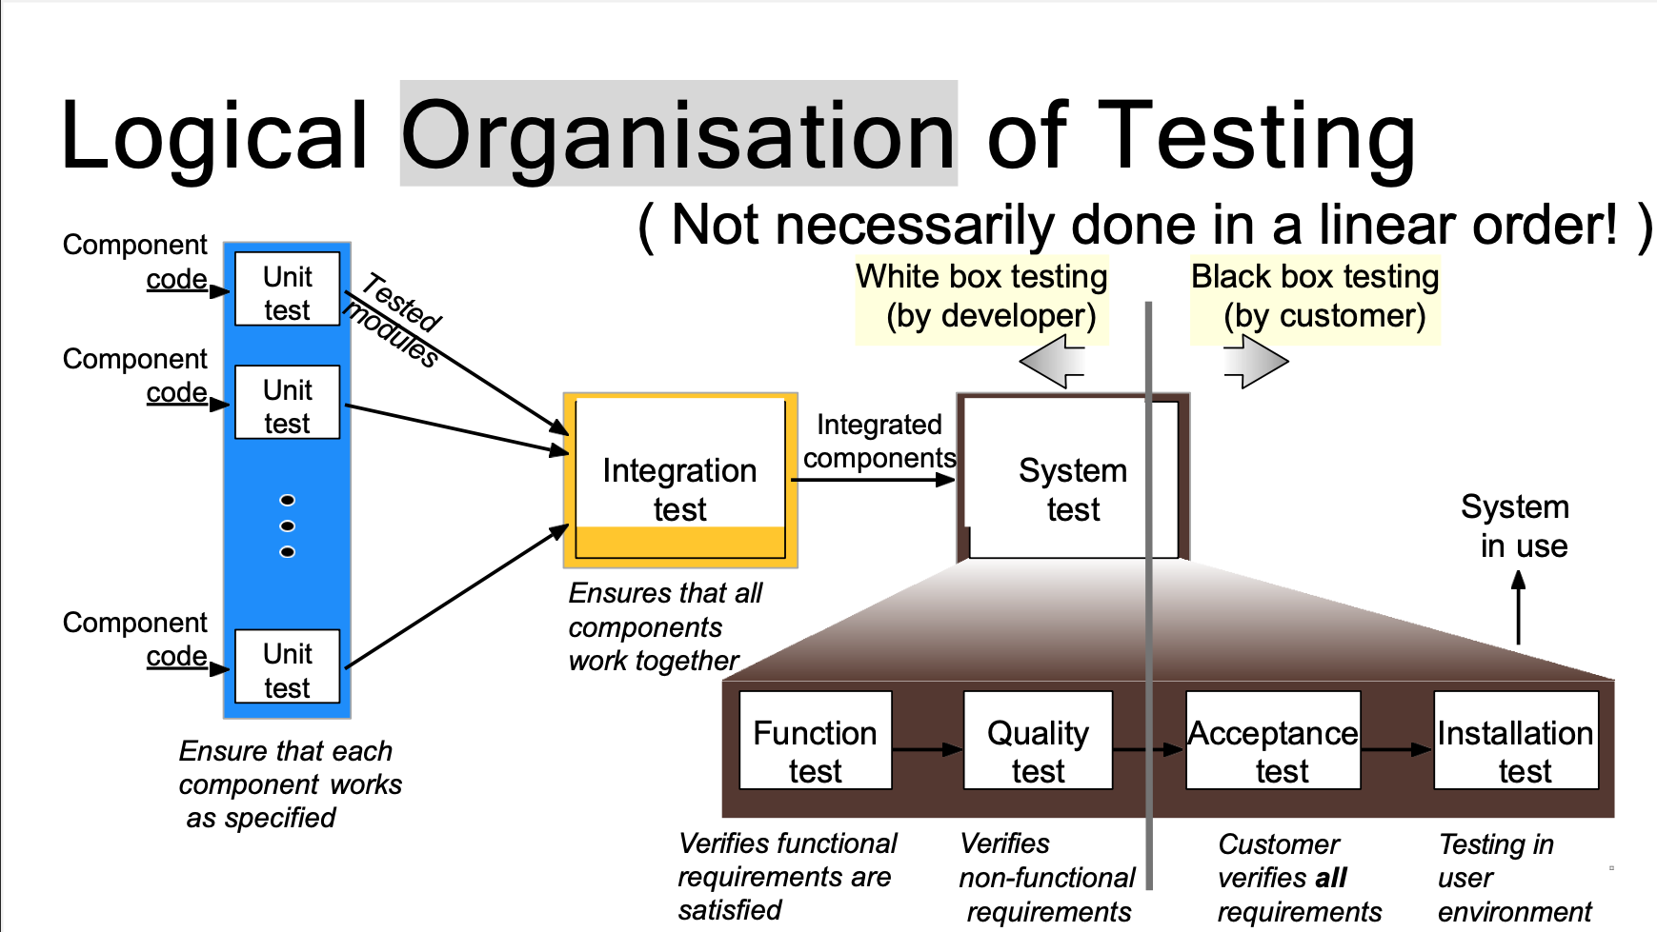

Slide 22
Logical Organisation of Testing
White box testing – the internal structure, design and code of a system are tested
The internal workings of the system are transparent to whoever is testing
Black box testing – the software system is tested from the perspective of an end-user
The internal workings of the system are hidden from the tester

Slide 23
Acceptance Tests (recall lecture 2 on Requirements)
form of black-box testing
Test with the valid key of a current tenant on his/her apartment (pass)
Test with the valid key of a current tenant on someone else’s apartment (fail)
Test with an invalid key on any apartment (fail)
Test with the key of a removed tenant on his/her previous apartment (fail)
Test with the valid key of a just-added tenant on his/ her apartment (pass)

Slide 24
Unit Testing – the smallest possible part of a system – called a unit – is tested individually and independently
Integration Testing – tests how components of a system interact with each other
System Testing (end-to-end) – tests an entire system Functional Testing – tests the functional requirements of a system
Quality Testing – tests the non-functional requirements of a system e.g. security, performance, usability, scalability, etc.
Acceptance Testing – customer verifies that the requirements have been met
Installation Testing – tests that the system works as intended when deployed to the end-user’s device

Slide 25

How do we know that we’ve tested enough?
Notes:
Afterall, principles of TDD say don’t do anything unless you can test it and measure success.

Slide 26

Coverage
coverage measures the degree to which the specification or code of a software program has been exercised by tests
Test Coverage AKA (Big picture): Specification testing focuses on the coverage of the input space, without necessarily testing each part of the software ⬅ Acceptance tests
Code Coverage (Implementation details): Code coverage measures the degree to which the elements of the program source code have been tested ⬅ Unit tests

Slide 27
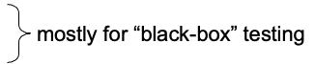
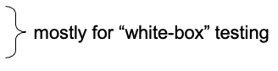
Testing
Test cases should be prioritized—some tests are more likely to uncover faults
Tests are about finding developer errors, and people are prone to make certain kind of errors
Some tests can easier pinpoint problems than others
(some) Heuristics for achieving high coverage: (could be applied individually or in combination)
equivalence testing
boundary testing
control-flow testing
state-based testing

Slide 28

Equivalence Testing
Equivalence testing is a black-box testing method that divides the space of all possible inputs into equivalence groups/classes such that the program is expected to “behave the same” on each input from the same group
Assumption: A well-intentioned developer may have made mistakes that affect a whole class of input values
Assumption: We do not have any reason to believe that the developer intentionally programmed special behavior for any input combinations that belong to a single class of input values
Notes:
We have a few assumptions at play.

Slide 29

Equivalence groups/classes?
Step 1: partition the input values into equivalence classes
Step 2: test one or more inputs from each equivalence class
Notes:
So, instead of testing every combination of 4 digit pins, we could just test a few combinations. How do we decide which ones though?

Slide 30
Example: user needs to enter a 6-digit OTP. Any other number of digits should be invalid.
Step 1: partition the input values into equivalence classes length = 6, length < 6, length > 6
Step 2: test one or more inputs from each equivalence class
length = 6 : 123456, 420666 – valid OTP
length < 6 : 12, 8453 – invalid OTP
length > 6 : 123456789, 7493640323782738 – invalid OTP

Slide 31
Heuristics for Finding Equivalence Classes
For an input parameter specified over a range of values, e.g., a number or a letter, partition the value space into one valid and two invalid equivalence classes
For an input parameter specified with a single value, e.g., a unique “security code,” partition the value space into one valid and two invalid equivalence classes
For an input parameter specified with a set of values, e.g., day or month names, partition the value space into one valid and one invalid equivalence class
For an input parameter specified as a Boolean value, partition the value space into one valid and one invalid equivalence class
Notes:
Heuristics means rule of thumb

Slide 32
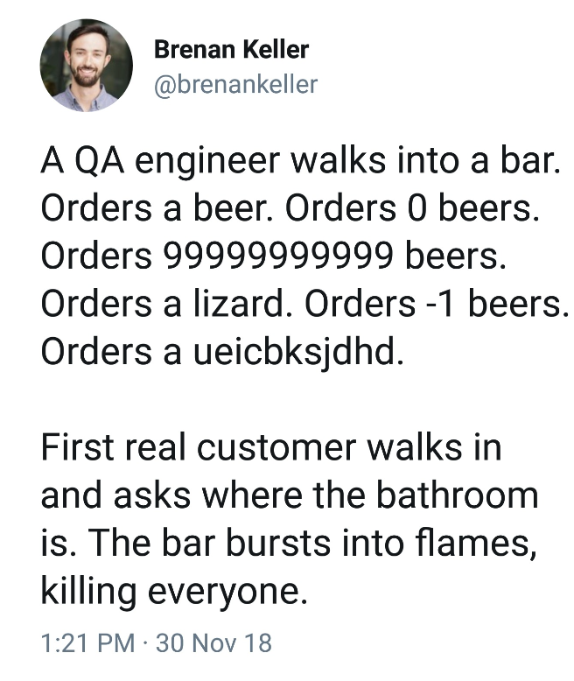
Boundary Testing
Boundary Testing, also called Boundary Value Analysis, is a special case of equivalence testing that focuses on the boundary values of input parameters
Assumption: developers often overlook special cases at the boundary of equivalence classes
Selects inputs from the “edges” of each equivalence class, or “outliers” such as
zero, min/max values, empty set, empty string, and null
confusion between > and >=
etc.

Slide 33
Boundary Testing example
Example: a marks system. Students pass if their mark is 50% or more, get a merit if their mark is 75% or more and a distinction if their mark is 85% or more. Otherwise, students fail.
Equivalence classes:
Valid: fail, pass, merit, distinction
Invalid: < 0, > 100
Boundary Test inputs:
fail (0, 49), pass (50, 74), merit (75, 84), distinction (85, 100),
< 0 (-1), >100 (101)
Notes:
We said, if you have a range, you should have 3 classes (one valid and two invalid). Here we have multiple ranges for each of those rangenges, we produce 3 equivalence classes.

Slide 34
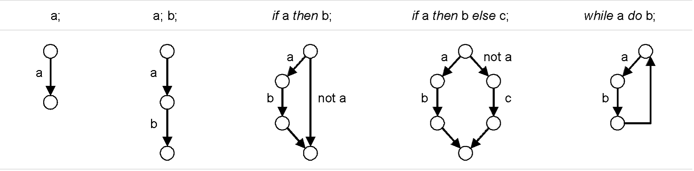
Control-flow Testing
Control Flow Testing organises testing based on the control flow of the software
Relies on understanding the code of the software (therefore white-box)
Can draw a control flow graph representing the logic of the code, where every statement is a node and every transition between statements is an edge

Slide 35
Control Flow Testing
Based on a control flow graph of the system, we can measure different types of code coverage:
Statement coverage – every statement executed at least once by some test case
Edge coverage – every branch of the control flow is traversed at least once by some test case
Condition coverage – every condition takes TRUE and FALSE conditions at least once in some test case
Path coverage – every distinct path through the program has been traversed at least once in some test case

Slide 36
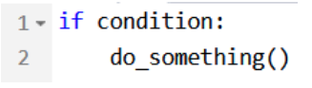
Control flow testing
Important: 100% statement coverage does not imply 100% edge coverage
Example:
If condition is always true, we achieve 100% statement coverage, but never test the case where condition is false and do_something() is skipped

Slide 37
State-based Testing
State-based testing defines a set of abstract states that a software unit (object) can take and tests the unit’s behavior by comparing its actual states to the expected states
This approach is popular with object-oriented systems
Like equivalence classes, state diagrams usually are mind constructs and may be incomplete (not showing all possible states and transitions) or incorrect
The state of an object is defined as a constraint on the values of its attributes
Because the methods use the attributes in computing the object’s behavior, the behavior depends on the object state
An object without attributes does not have states, but still can be unit-tested

Slide 38
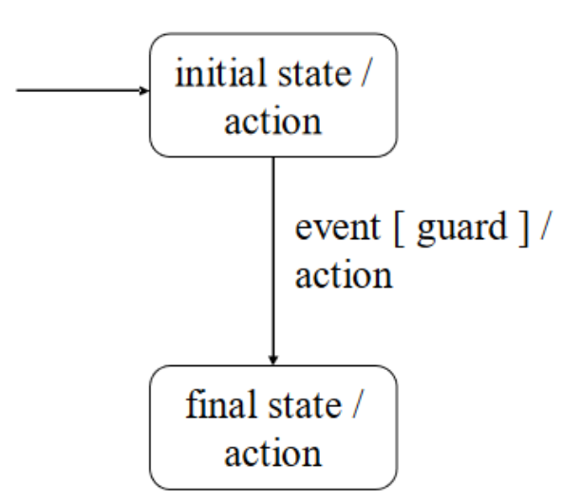
State-based testing components:
State – a constraint on the values of an object’s attributes
Event – an input given to the system
Action – the result, output or operation that follows an event
Transition – a change of state caused by an event
Guard – a condition associated with an event which determines whether a transition is triggered or not

Slide 39
State-based Testing Example Consider a home access system
Define the relevant states as combinations of object attribute values:
“Locked” ≡ defined as: (lockDeviceArmed == true) && (numOfAttempts == 0)
“Accepting” ≡ defined as: (lockDeviceArmed == true) && (0 < numOfAttempts < maxNumOfAttempts)
“Unlocked” ≡ defined as: (lockDeviceArmed == false) && (numOfAttempts == 0)
“Blocked” ≡ defined as: (lockDeviceArmed == true) && (numOfAttempts == maxNumOfAttempts)
“Undefined” ≡ defined as: ((numOfAttempts < 0) || (maxNumOfAttempts < numOfAttempts)) || ((lockDeviceArmed == false) && (numOfAttempts != 0))
Define the relevant events:
User entered a valid key
User entered an invalid key

Slide 40
State-based Testing Example

Slide 41
event
guard condition
State – a constraint on the values of an object’s attributes
Event – an input given to the system
Action – the result, output or operation that follows an event
Transition – a change of state caused by an event
Guard – a condition associated with an event which determines whether a transition is triggered or not
action
state
transition
Notes:
Four states { Locked, Unlocked, Accepting, Blocked }
Two events { valid-key, invalid-key }
Five valid transitions { Locked→Unlocked, Locked→Accepting, Accepting→Accepting, Accepting→Unlocked, Accepting→Blocked }

Slide 42
Types of state-based coverage
Event coverage every event is tested
State coverage every state is visited
Action coverage every action is triggered

Slide 43
Control Faults
In state-based testing, control faults refer to defects or errors in the control flow logic of the software under test. These faults can lead to incorrect transitions between states or improper handling of conditions within the system.

Slide 44
Common control faults
Missing transition – nothing happens with an event
Incorrect transition – resulting state is incorrect
Inconsistent State Transition - inconsistency can lead to non-deterministic behaviour,
Looping or Infinite State Transition – can lead to system being unresponsive
Missing or incorrect action – wrong thing happens on transition
Incorrect State Handling - Extra, missing or corrupt state
Sneak path – event is accepted when it shouldn’t be
Trap door – implementation accepts undefined events
Deadlocks and Livelocks - conflicting resource dependencies or synchronization issues. Deadlocks result in a permanent blocking of system resources, while livelocks involve the system continuously reattempting to make progress without success.

Slide 45
Unit Tests

Slide 46
Unit Testing
Unit Testing – the smallest possible part of a system – called a unit – is tested individually and independently
Unit is sometimes called a fixture
To test a unit in isolation, we create mock objects to represent components that are external to the unit
Test driver – simulates a part of a system that invokes operations on the unit
Test stub – simulates a part of a system that is called by the unit
Unit testing cycle:
Create the unit, test driver and test stub(s)
Have the test driver invoke an operation on the unit Ensure that the unit behaves as expected

Slide 47
Unit Testing the keychecker
(a)
(b)

Slide 48
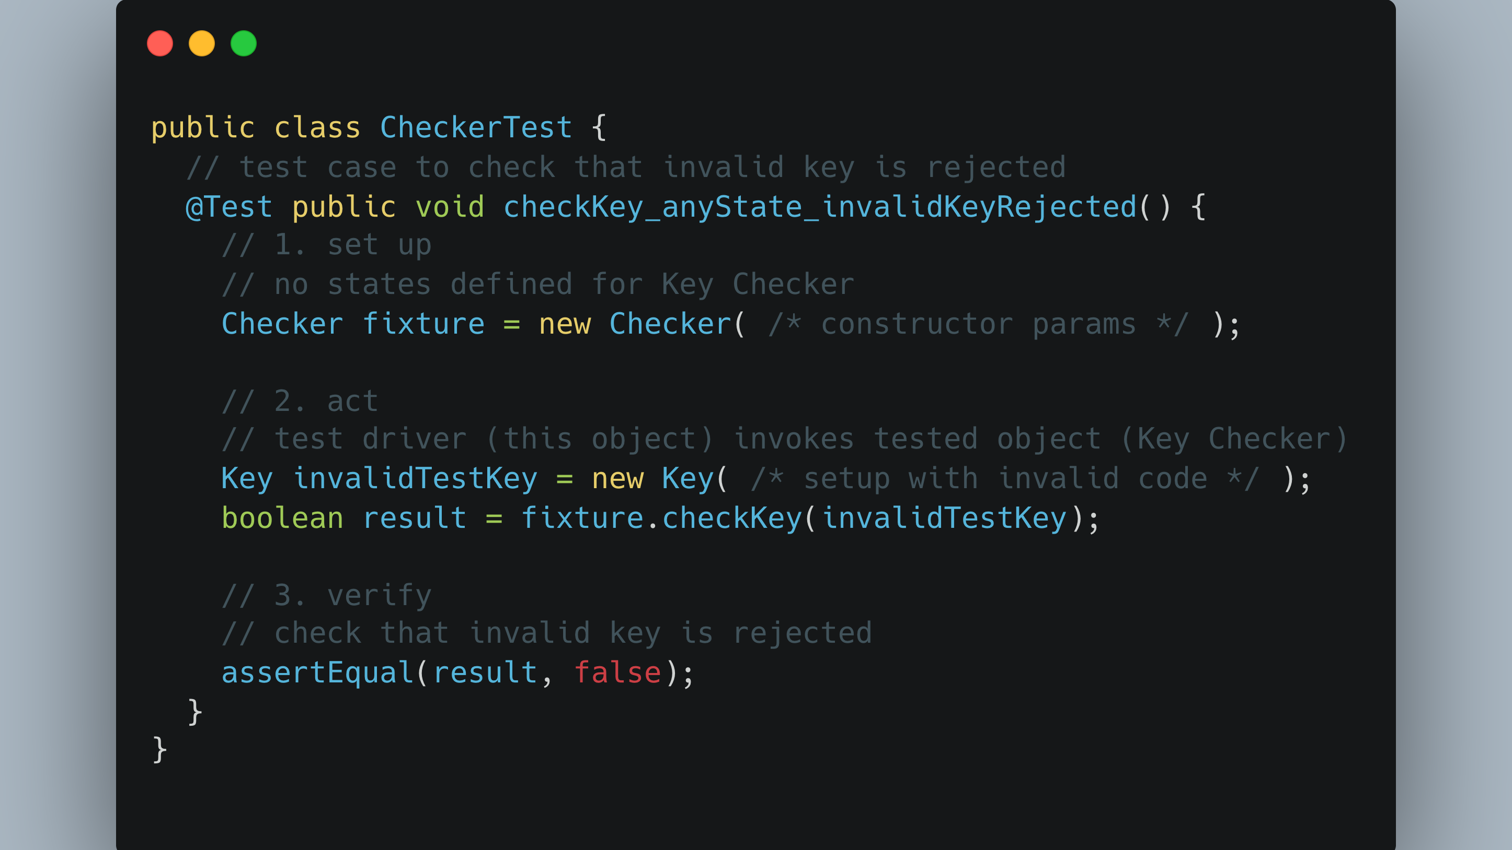

Slide 49
Test Case Method Naming
Example test case method name:
checkKey_anyState_invalidKeyRejected()

Slide 50
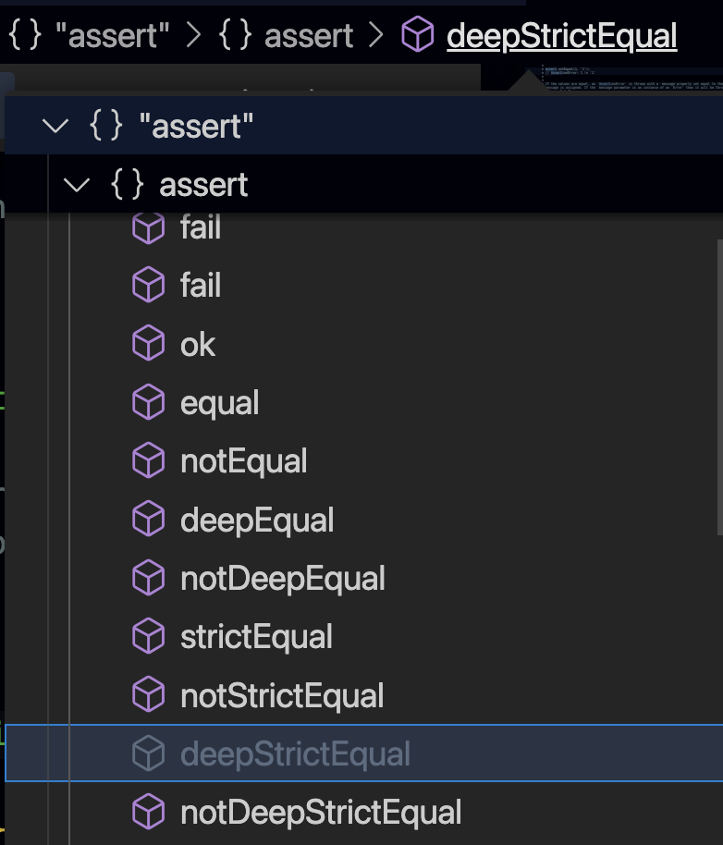
Unit Testing
Verification of the expected result usually achieved using assert statements
Examples:
assertTrue(4 == (2 * 2));
assertEquals(expected, actual);
assertNull(Object object);

Slide 51
Unit Test Example
Add(int a, int b) { return a+b; }
isPrimeNumber

Slide 52
Is our testing of the isPrime unit sufficient?
Equivalence Class
Bool so 2
isPrime & isNotPrime (TRUE & FALSE)
Other considerations:
What about input types?
What about negative integers?
What about null, undefined, etc?

Slide 53
Integration Testing
Tests how components of a system interact with each other
Many types:
Big bang integration
Top-down integration
Bottom-up integration
Sandwich integration
Horizontal integration vs vertical integration

Slide 54
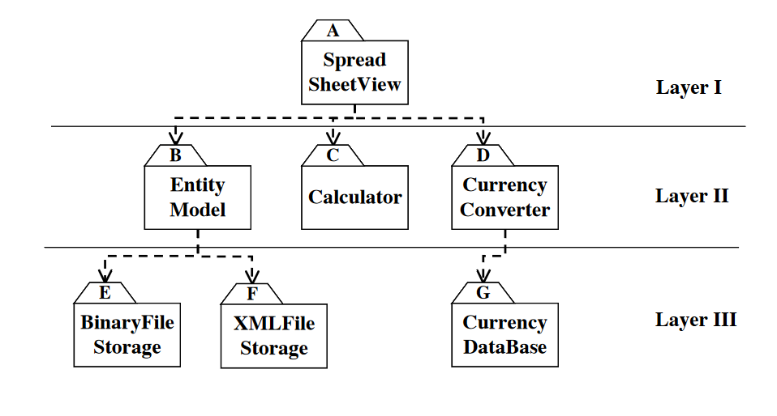
Integration Testing example

Slide 55
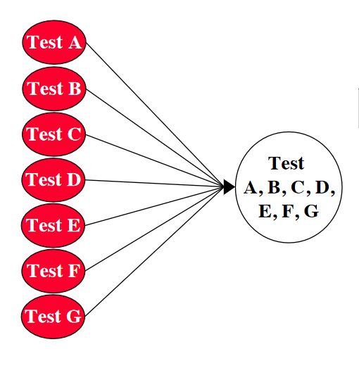
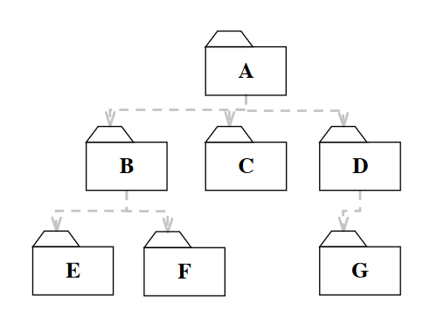
Integration Tests
Big Bang integration – all units are linked at once and the entire system is tested

Slide 56
Integration Tests : Big bang
Big Bang testing is to be avoided at all costs
Faults can only be identified once the whole system is implemented
Very difficult to isolate bugs once they are detected
Highly probable that bugs will be missed in testing
Difficult to ensure that all cases are tested

Slide 57
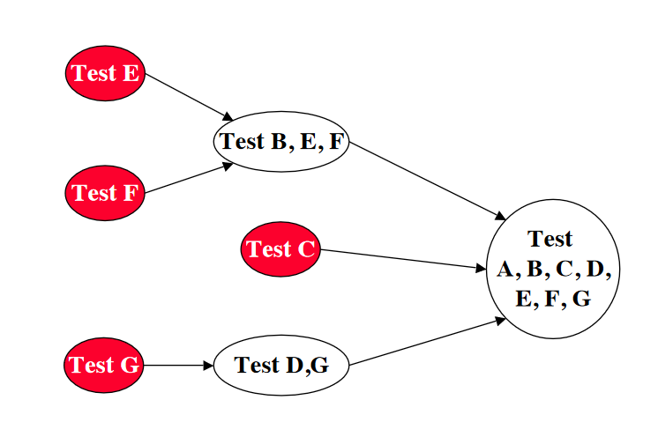
Integration Tests
Bottom-up testing – lowest level subsystems are tested first. An integrated component can only be tested once the components it relies on are tested.
Relies on drivers to simulate top-level execution

Slide 58
Integration Tests: Bottom-up integration
Pros:
No need to implement stubs
Disjoint subsystems can be tested simultaneously
Lower-level operations are usually critical to higher level components, so testing them first is usually a priority
Cons:
Drivers are needed
Certain higher-level components (e.g. user interfaces) can be the source of many bugs
With many lower-level components, bottom-up integration can tend towards big bang integration

Slide 59
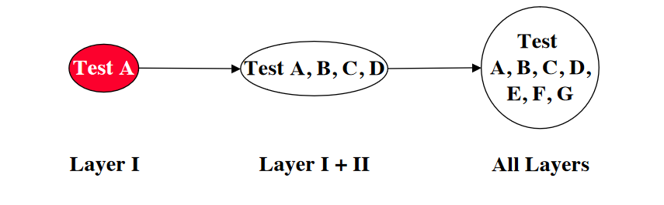
Integration Tests
Top-down testing – highest level subsystems are tested first. An integrated component can only be tested once all components that invoke it are tested.
Relies on stubs to simulate lower-level processes

Slide 60
Integration Tests: Top-down integration
Pros:
No need to implement drivers
Easier to write test cases in terms of functional requirements
Can deal with major design flaws earlier in the process
Cons:
Stubs are needed
Often lots of stubs
Lower-level functionality only really tested once higher-level components are implemented

Slide 61
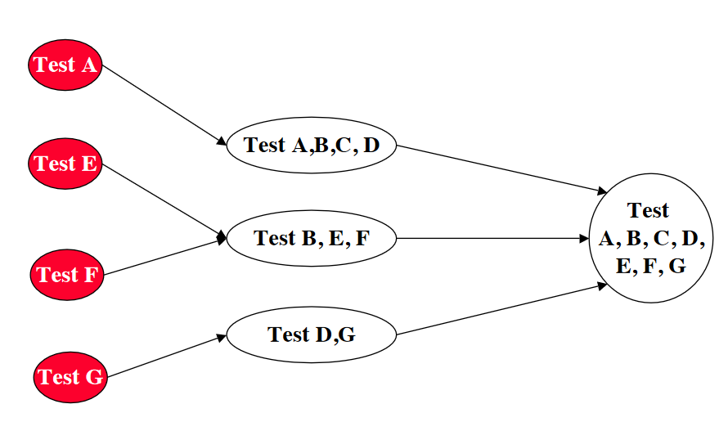
Integration Tests
Sandwich testing – combines top-down and bottom-up approaches. Testing converges on a target layer.

Slide 62
Integration Tests: Sandwich integration
Pros:
Easier to test larger systems
Cons:
Testing can be expensive
Low- and high-level components tested simultaneously
Is less suitable for architectures with highly independent subsystems
More developers, stubs and drivers

Slide 63

Front-end component testing
Front-end component testing involves testing individual components of a user interface, such as buttons, forms, dropdowns, and other UI elements, in isolation to ensure they function correctly and meet the specified requirements. These tests are typically performed at the component level and focus on verifying the behavior, appearance, and interactions of individual UI elements.

Slide 64
Front-end component testing encomposes
Unit Testing: Tests individual components in isolation, verifying their behavior and logic.
Integration Testing: Tests how components interact with each other within the application.
Snapshot Testing: Captures and compares rendered component output to detect UI changes.
End-to-End Testing: Tests the entire application from the user's perspective.
Component Storybook: Develops and documents components in isolation with a visual interface.
Accessibility Testing: Ensures components are usable by people with disabilities.
Visual Regression Testing: Compares component screenshots to detect unintended visual changes.
Performance Testing: Evaluates component responsiveness and efficiency.

Slide 65
Integration Tests
Horizontal Integration Testing
Assumes a hierarchical design
Focuses on testing layers of a system, with new layers incrementally added to a test
Examples: top-down, bottom-up and sandwich
Vertical Integration Testing
Focuses on testing scenarios or user stories
Test all the components needed to realise a particular user story

Slide 66
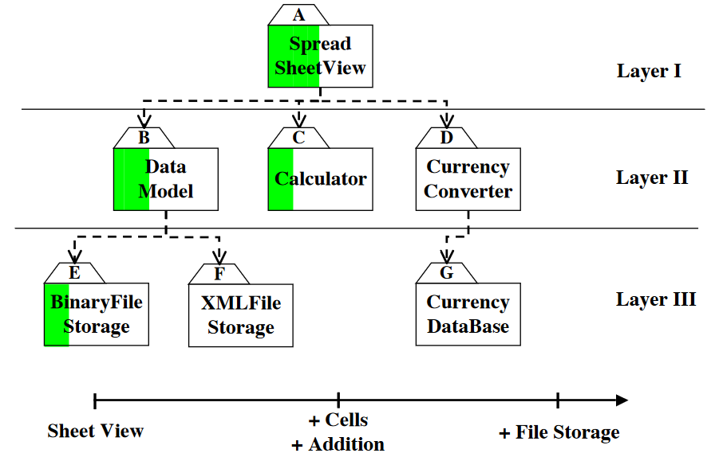
Vertical Integration Testing:

Slide 67
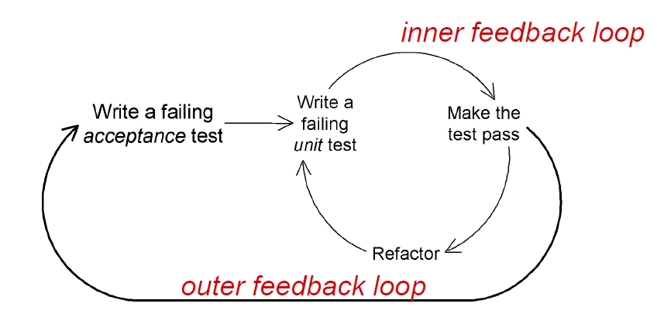
Integration Testing
User stories as part of a testing loop

Slide 68
Continuous Integration

Slide 69
Continuous Integration (CI)
Running tests is a big part of continuous integration
Every time a new build is generated (see build automation):
Run unit tests on changed components
Run regression tests on unchanged components to ensure they still work as intended
Run integration tests on the system

Slide 70

Setup
Test Runner
Executes Test, Summarises results
Mocha
Jasmine
NUnit
PHPUnit
Pytest
Karma
Assertion Libraries
Defines testing logic, expectations
AssertJ
NUnit.Framework.Assert
JUnit.Assert
unittest.TestCase
unittest.mock
Headless Browsers
”in-code browser”
Puppeteer
Playwright
Headless Chrome
PhantomJS
Chai
Jest
Notes:
Include the CI one

Slide 71
Software Testing Tools
Continuous Integration
GitHub Actions
Azure DevOps Pipelines
Jenkins
Travis CI

Slide 72
System Tests
Test the system as a whole
Functional testing – test the functional requirements of a system
Tests are written from requirements specifications and user manuals and are centered on requirements and key functions
Quality Testing – tests the non-functional requirements of a system
Acceptance Testing – customer verifies that the requirements have been met
Installation Testing – tests that the system works as intended when deployed to the end-user’s device

Slide 73
Quality Tests
Stress testing – test beyond the normal limits of a system
e.g. use bots to test a server’s functionality during high loads
Volume testing – test with large volumes of data
Compatibility testing – test with older versions of software to ensure backwards compatibility
Timing testing – test response times
Security testing – attempt to violate software security, test how system responds
Recovery testing – test how system responds to errors or lack of data etc.

Slide 74
Acceptance Testing
Client verifies that requirements are met
User Acceptance Tests – Given-When-Then
See Lecture 2 - Requirements
Degrees of acceptance testing
Alpha Tests – client uses software in development environment; Developers on hand to fix issues
Beta Tests – conducted in production environment. Small subset of user base chosen to use system; Software gets a realistic workout in target environment

Slide 75
Conclusion
Test-Driven Development is important to build reliable software systems
Testing is a big part of continuous integration
We test at every stage of development
Testing is conducted at different levels of granularity
Unit Tests
Integration Tests
System Tests
Testing is an art, not a science
You can almost never guarantee you have a bug- free system
But many rules and heuristics exist to make testing tractable

Slide 76


